Slide 1


tutti - Assignment 5
on-demand peer-to-peer tutoring
Jennifer Lew, Jonah Blaydes Greenberg, Alex Yansouni, Meghana Paturu

Slide 2




Meet the Team!
Jennifer Lew (’26)
Computer Science (AI) Palos Verdes, CA
Alex Yansouni (’26)
Computer Science (HCI) Los Altos, CA
Meghana Paturu (’26)
Computer Science (HCI) &
Economics Belle Mead, NJ
Jonah Blaydes-Greenberg (’26)
Computer Science (HCI) & Music Los Altos, CA

Slide 3

Table of Contents / Outline
Intro
Sketching explorations
Selected interface
Low-fi prototype construction
3 task flows
Testing methodology
Testing results
Discussion
Appendix

Slide 4


Value Proposition:
On-Demand Tutoring You Can Trust
tutti provides reliable and convenient on-demand tutoring, connecting college students with knowledgeable peers who can offer convenient academic support.

Slide 5


Identifying the Problem and Solution
The Problem:
Our Solution:
Students struggle to find reliable peer tutors, leading to inconsistent and inefficient academic support experiences.
tutti offers a seamless platform connecting students for on-demand tutoring, using ai features to enhance learning

Slide 6
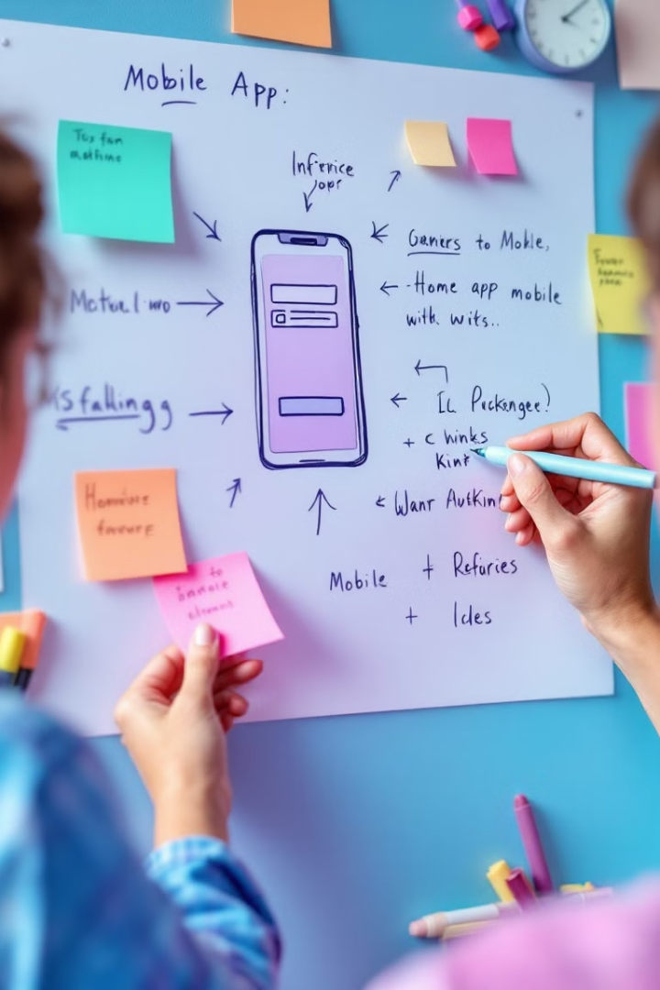
Sketching Exploration
Initial brainstorming involved exploring diverse interface possibilities, analyzing pros and cons of each to determine the most effective solution for tutti.

Slide 7

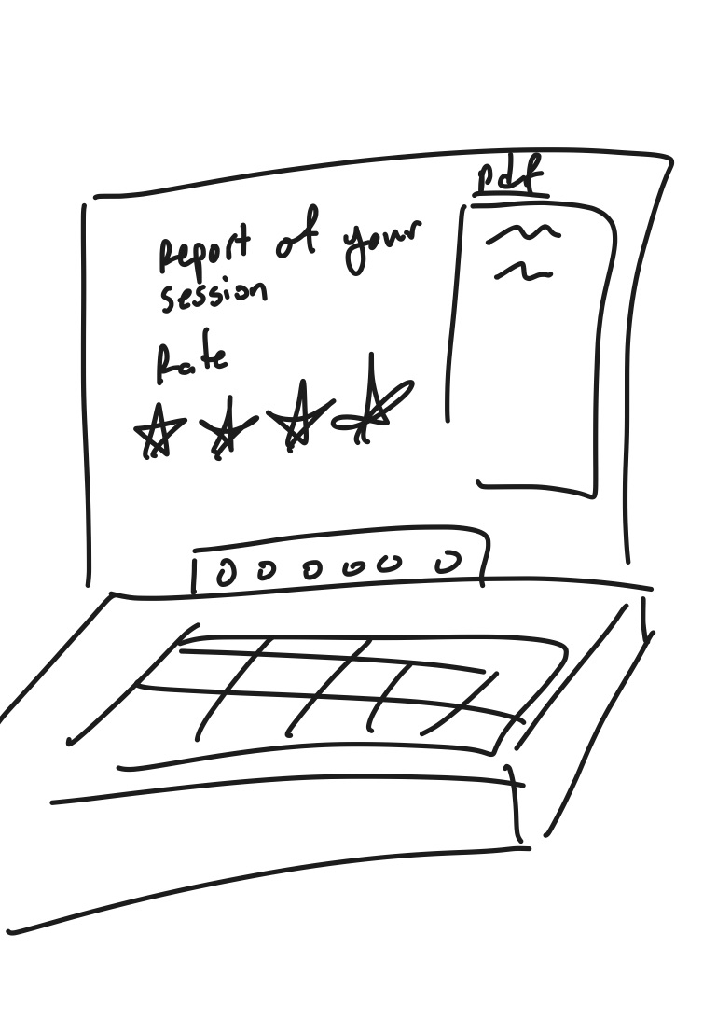
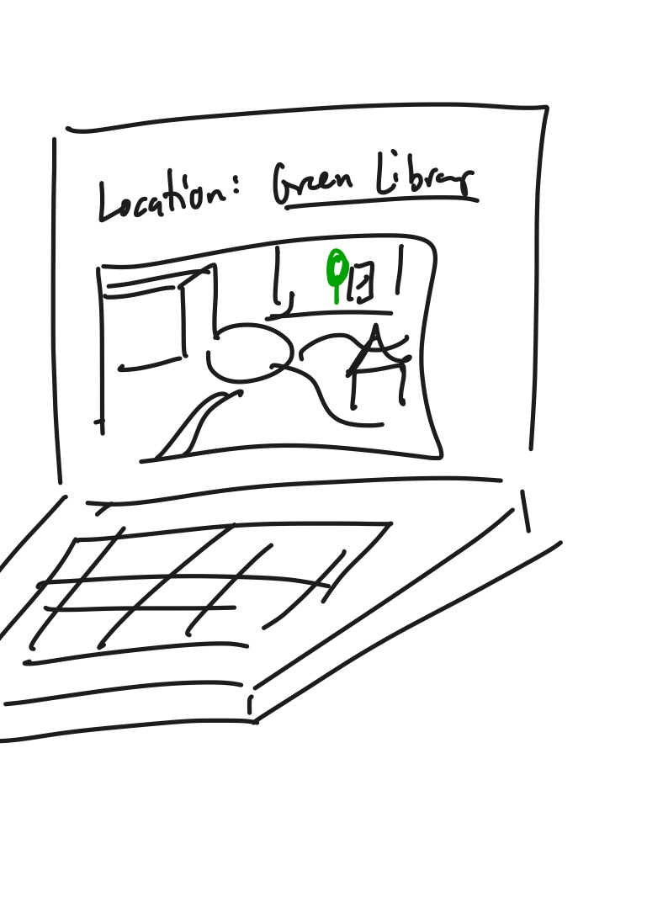
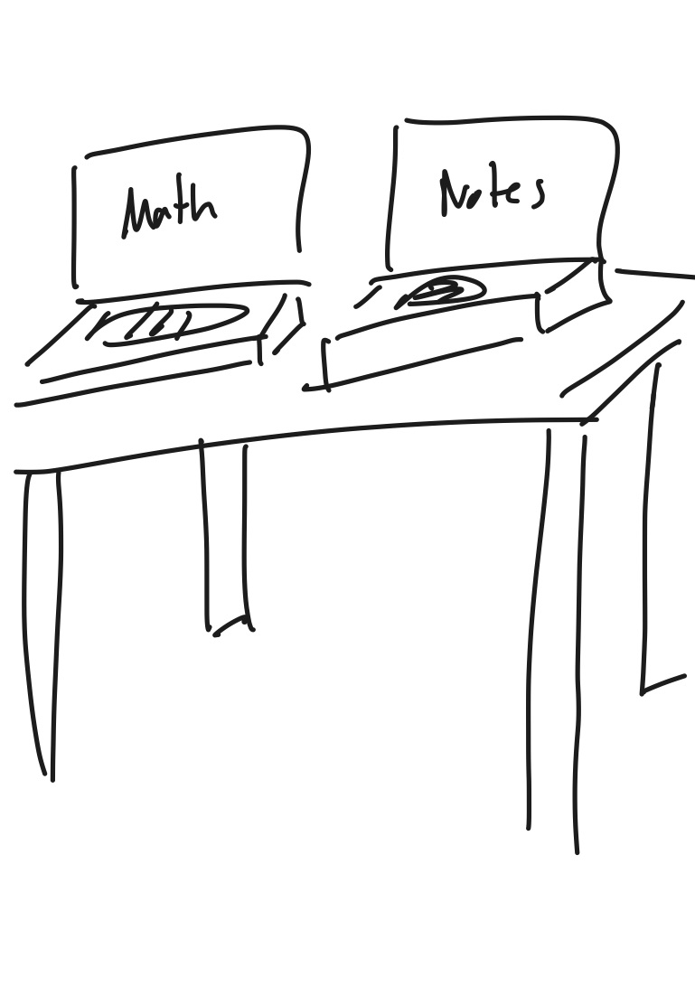
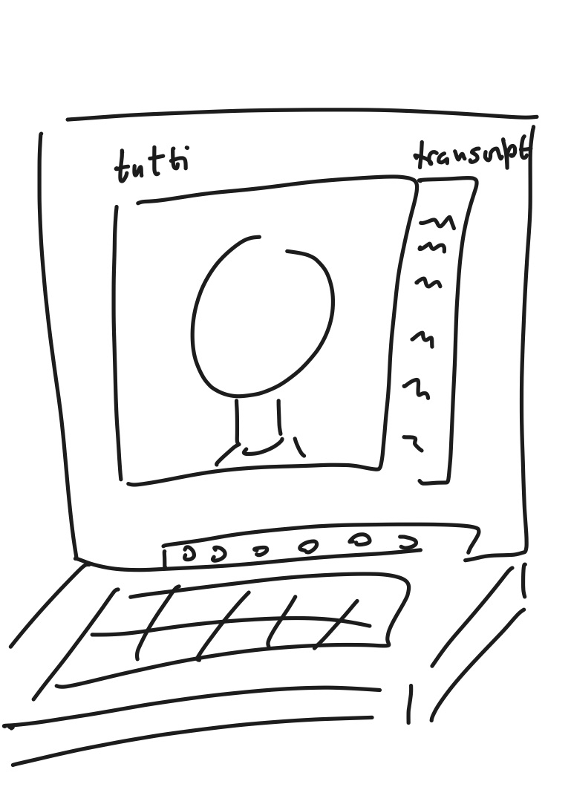
Concept 1: Web Application

Slide 8

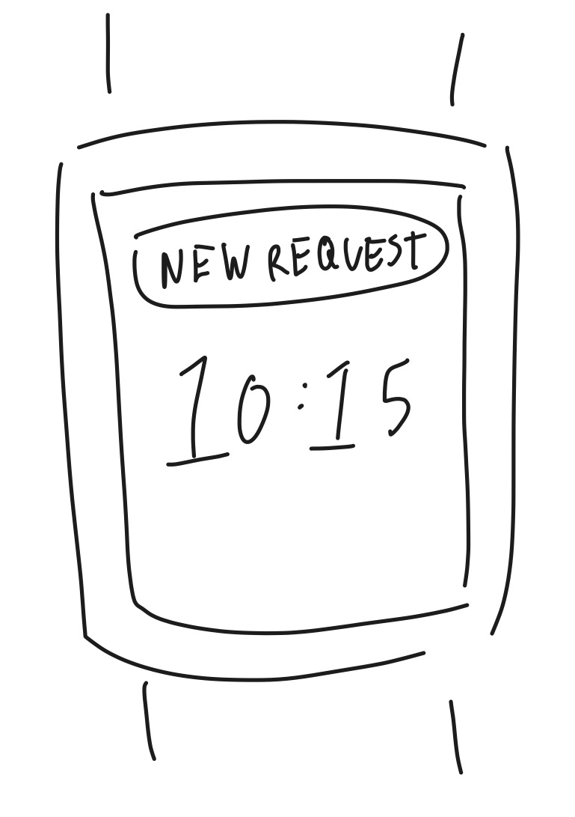
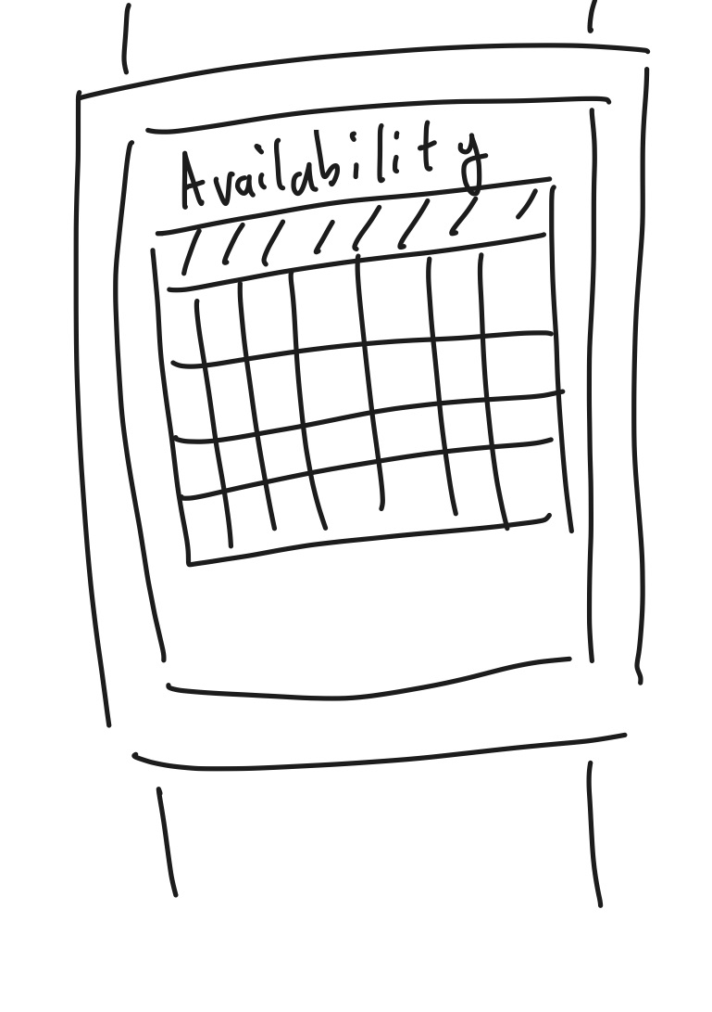
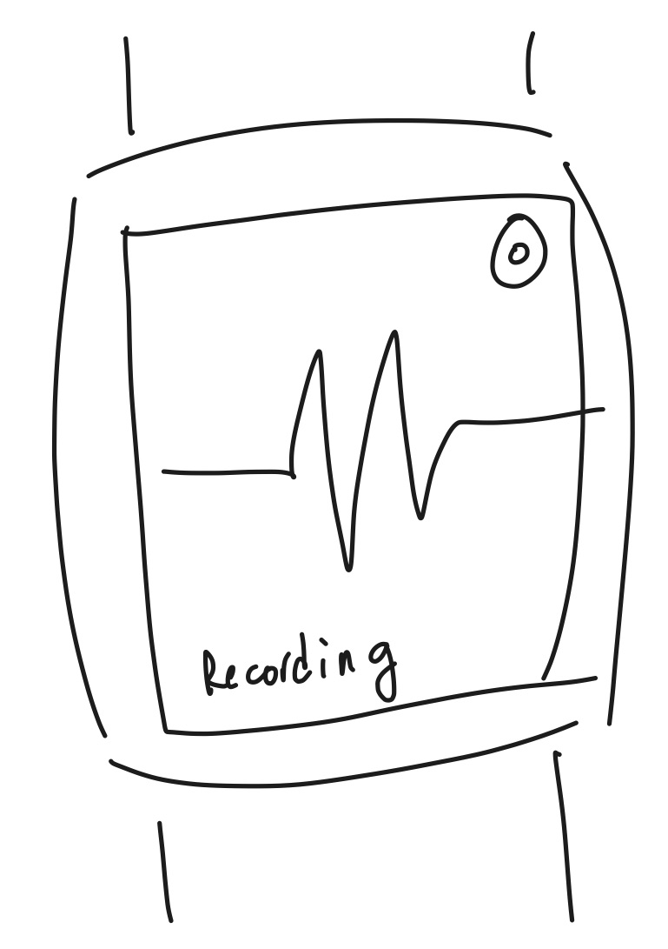
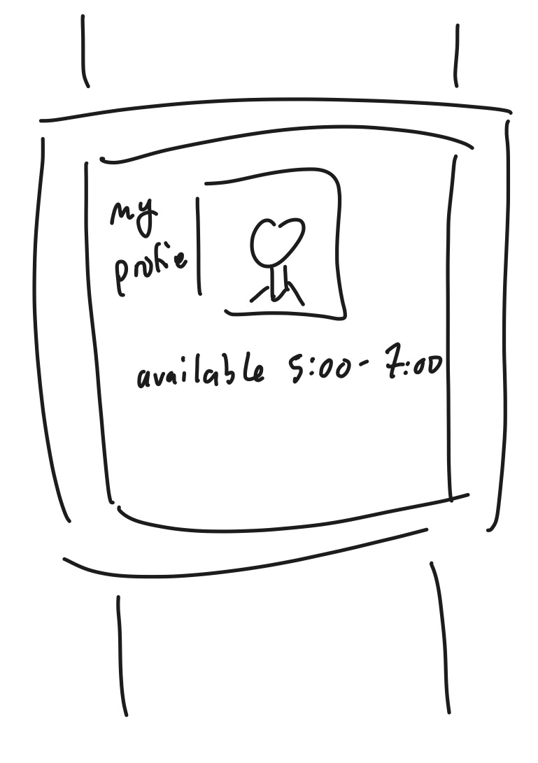
Concept 2: Wearable Application

Slide 9
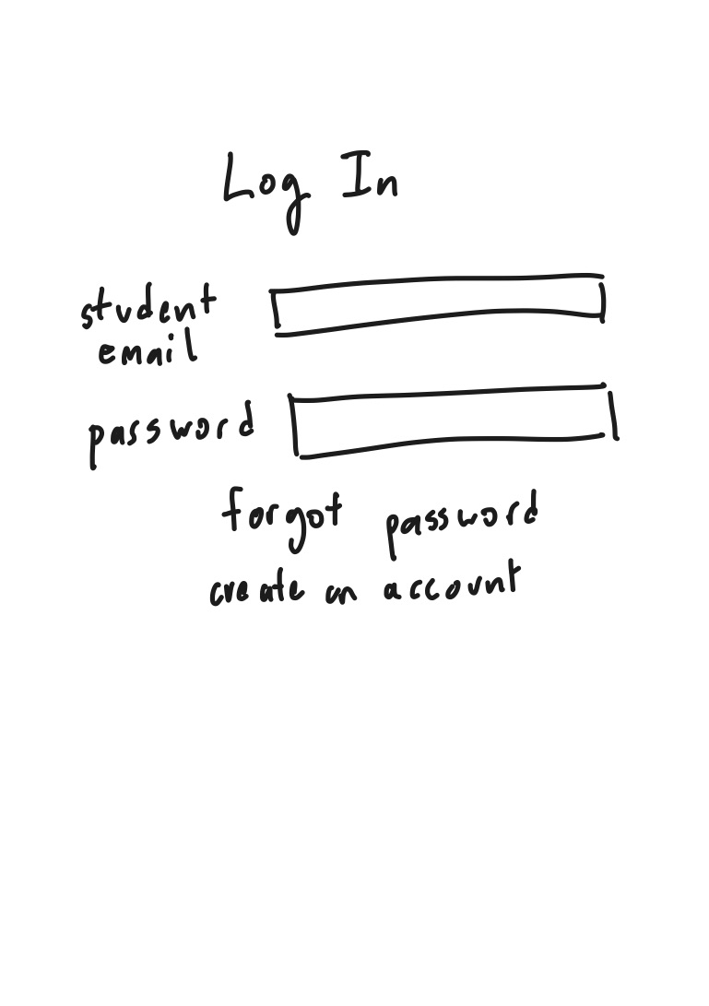
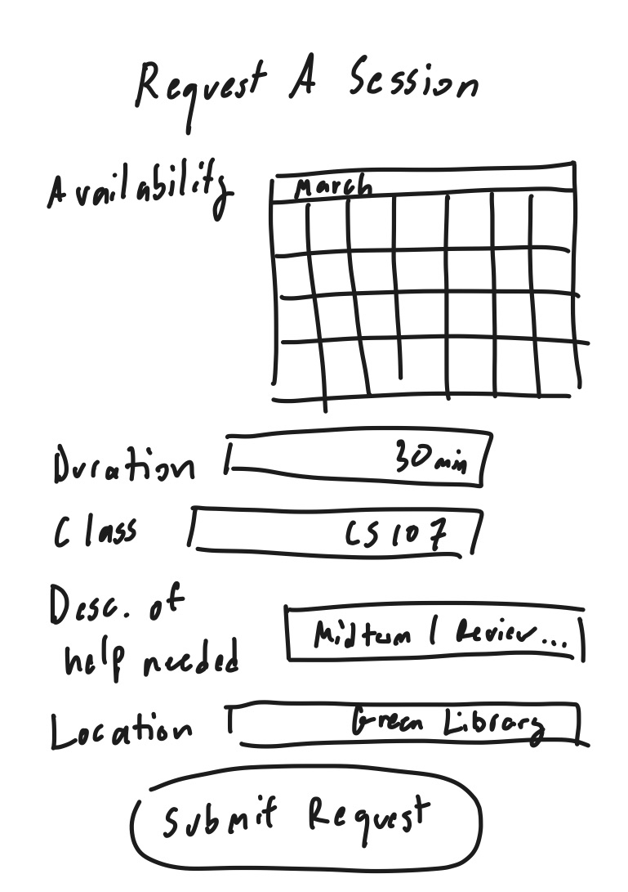
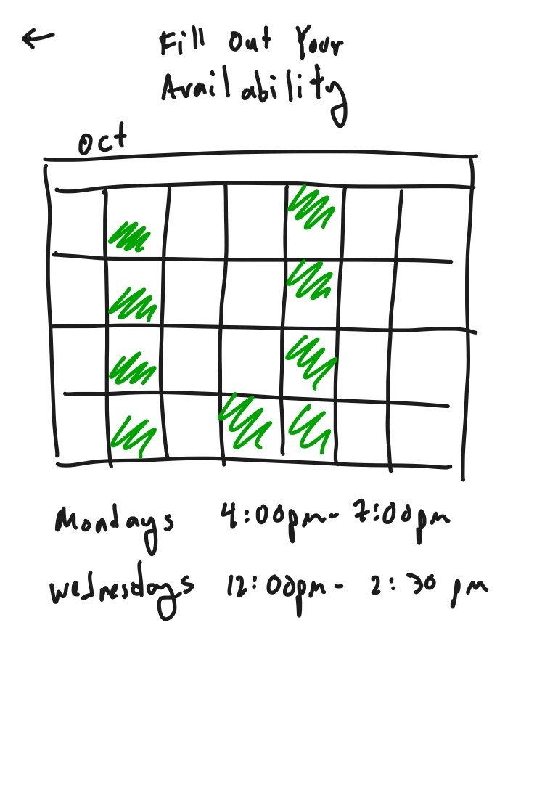
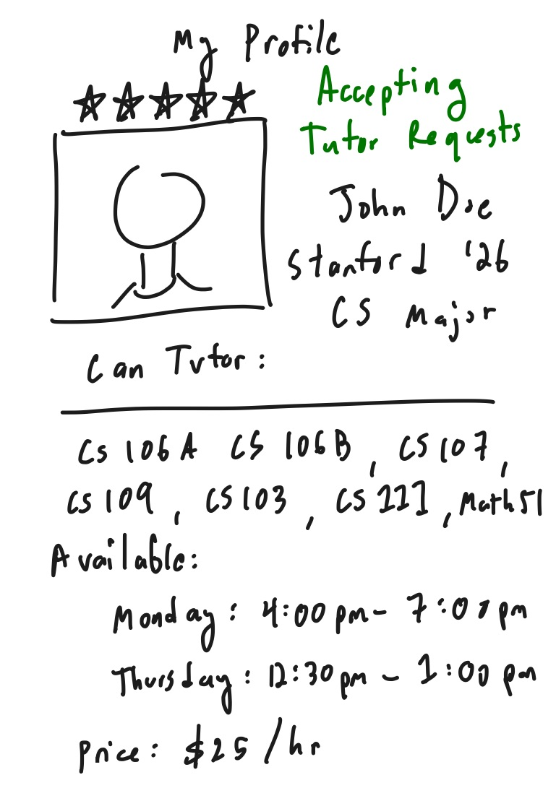
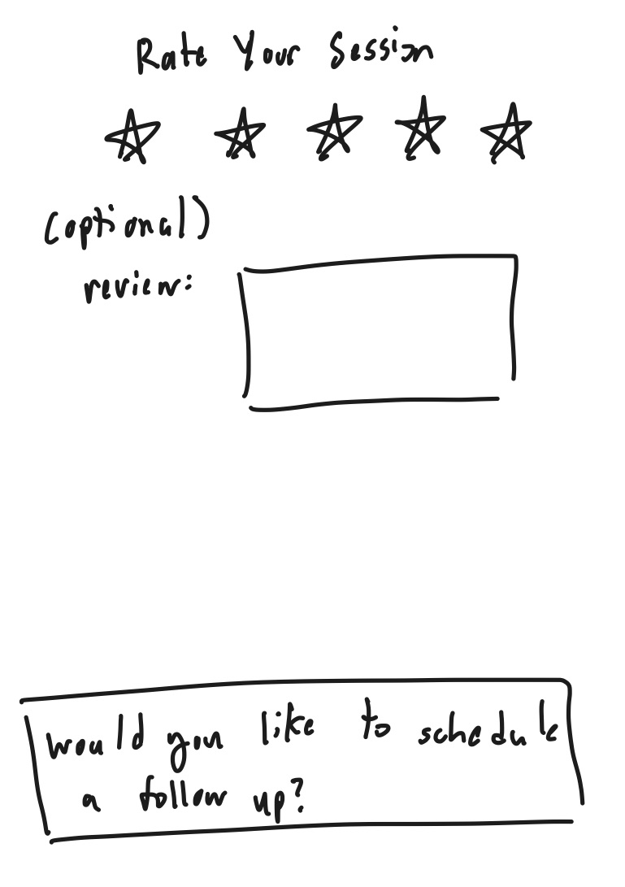
Concept 3: Mobile Application

Slide 10

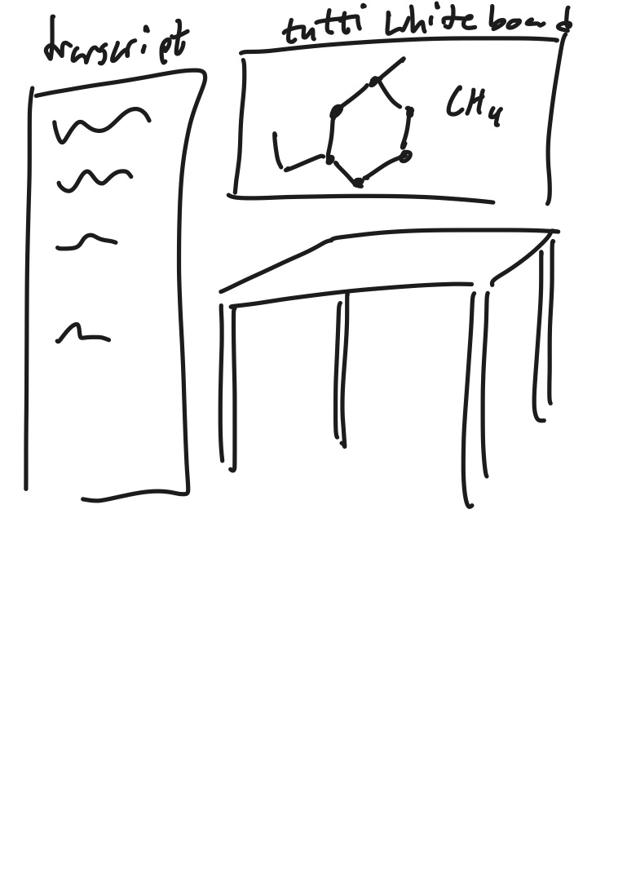
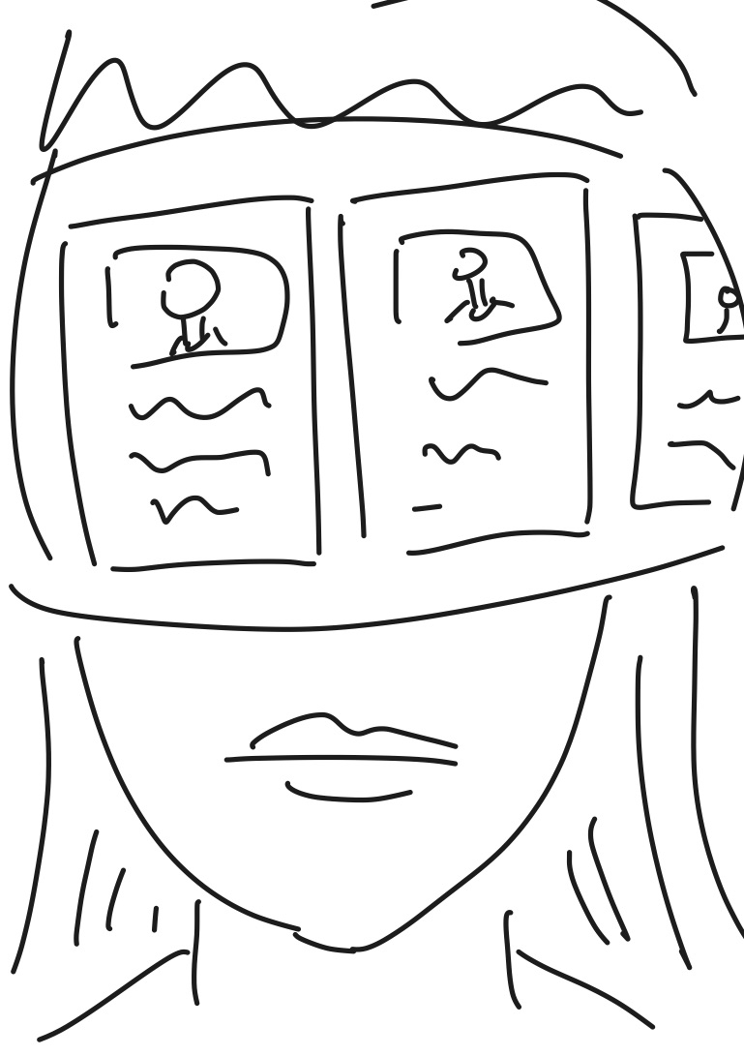
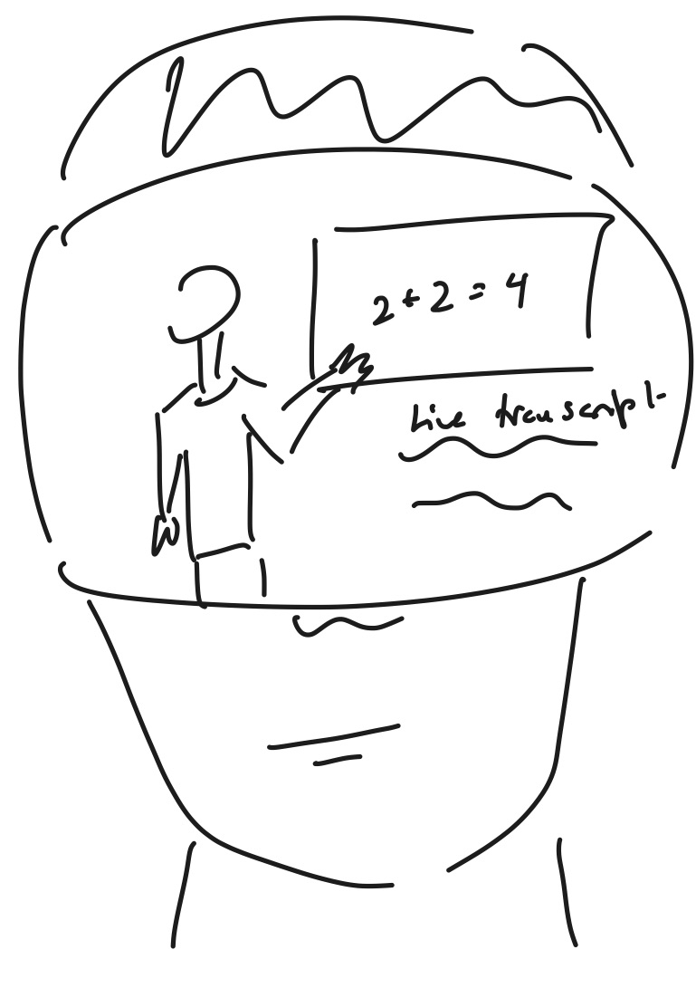
Concept 4: Augmented Reality

Slide 11


Top 2 Diverse Realizations
Our sketching exploration led us to focus on two primary interface options: a wearable application designed for smartwatches and a mobile application for smartphones.

Slide 12
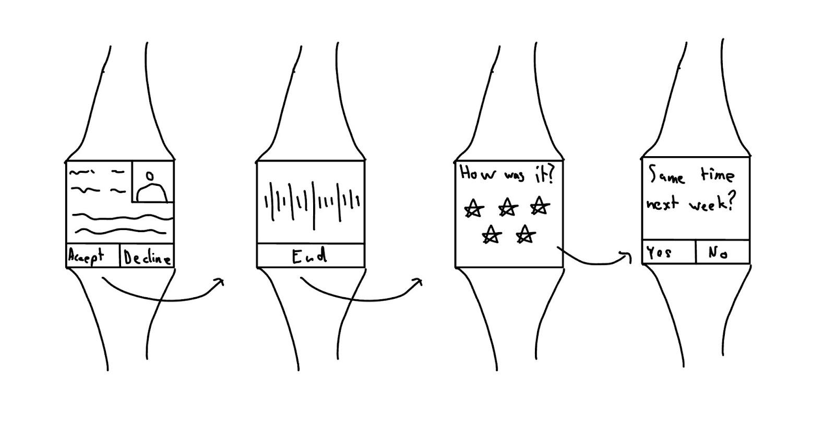
Wearable Application

Slide 13
Pros
Cons
Convenient: Immediate access, especially for notifications.
Intuitive and Quick: Very easy for receiving requests.
Easy Notifications: Simple alerts that users won't miss.
Expensive & Low Adoption: Fewer users own smartwatches compared to mobile phones.
Limited Display: Not enough room for detailed information

Slide 14
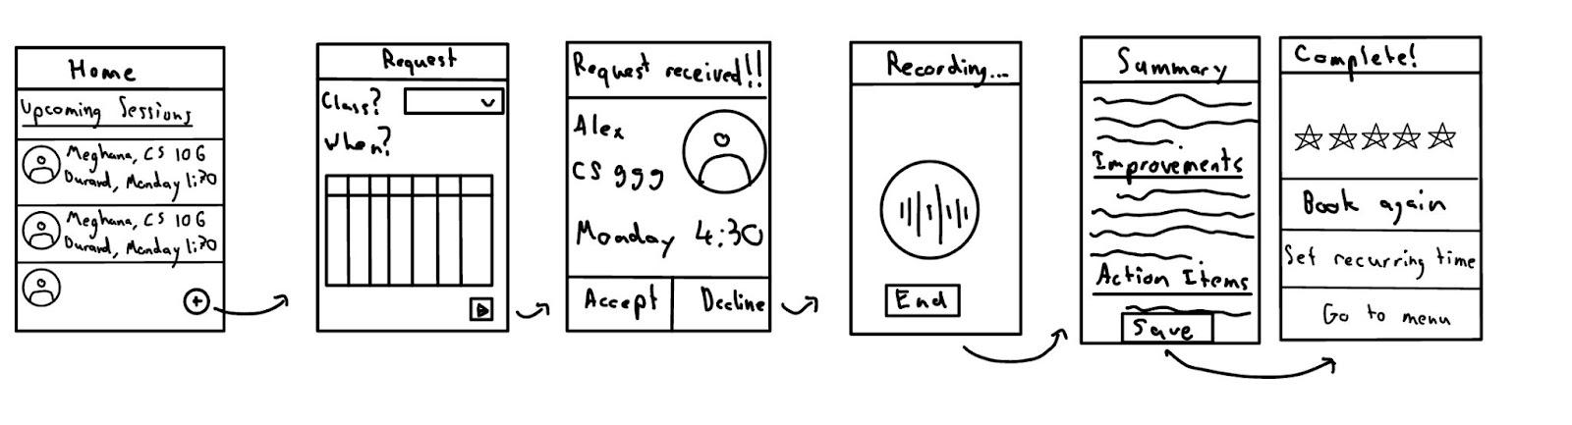
Mobile Application

Slide 15
Pros
Cons
Convenient & Accessible: Always available in your pocket.
Internet Connectivity: Easy to connect anywhere.
Frequent Usage: Users check their phones frequently, which ensures responsiveness.
Limited Detail: Screen size limits the information displayed.
File Upload Complexity: More challenging to upload large files compared to desktop.
Lower Battery Life: Frequent app usage can affect battery life.
Multiple Operating Systems: Requires design considerations for iOS and Android.

Slide 16
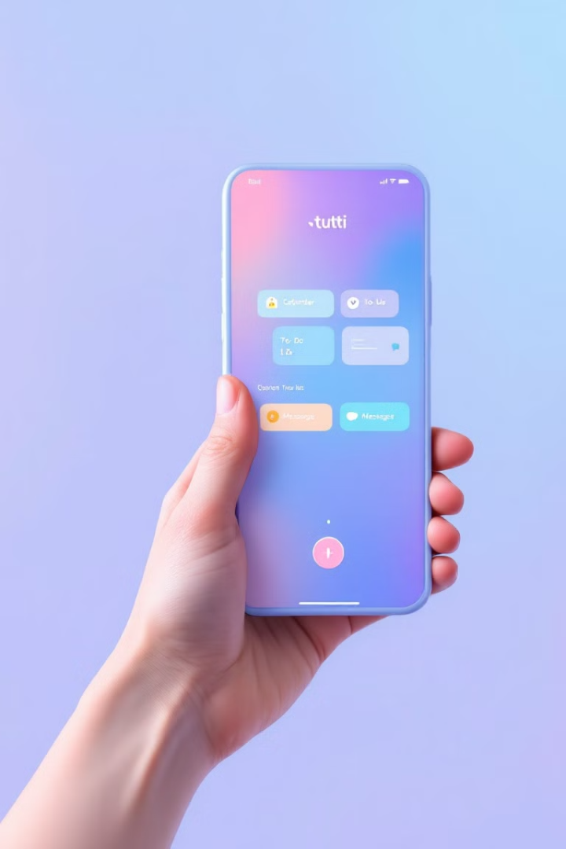
Selected Interface: Mobile Application

Slide 17
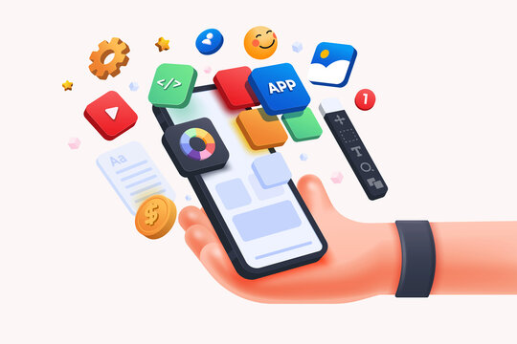
Mobile Application
Convenient & Accessible:
Support available anywhere, anytime.
Frequent Usage:
More likely to see and use tutoring notifications.
Broad Adoption:
The most accessible option.

Slide 18

Wearable Application
Low Adoption:
Few students own smartwatches
Limited Screen Size:
Small screens are not ideal for detailed tutoring content.
High Cost:
Wearables are expensive, which limits accessibility.
Limited Functionality:
Not suitable for complex interactions

Slide 19

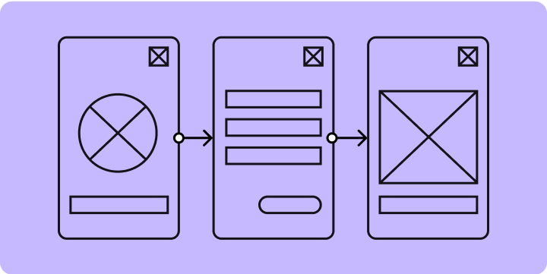
Low-Fidelity Prototype

Slide 20
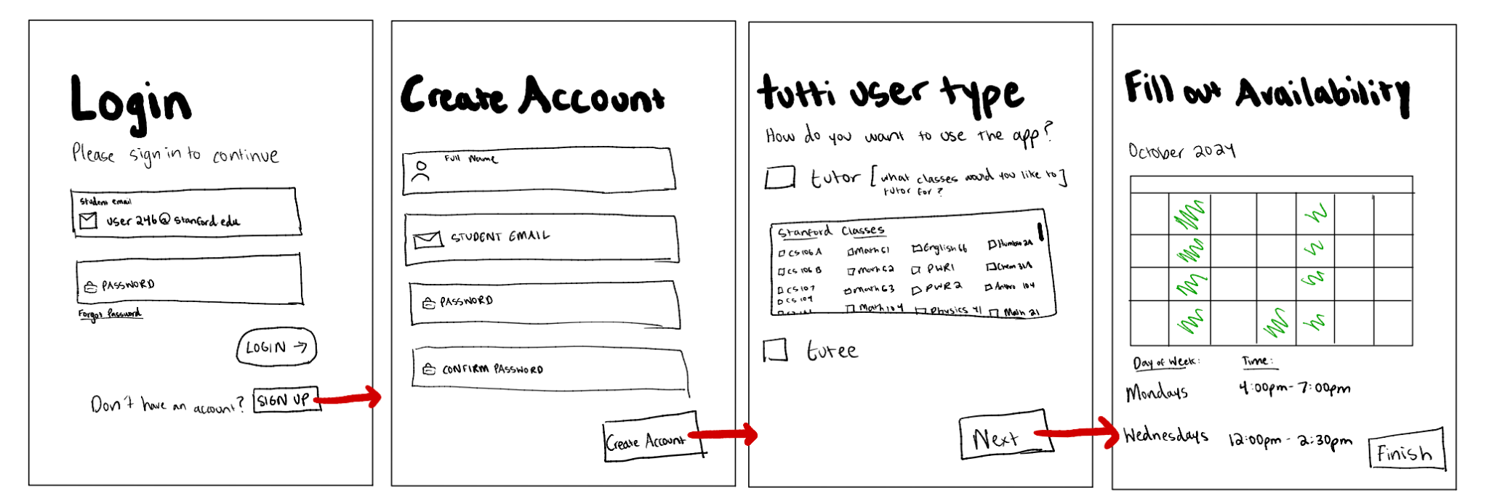
Log in and Create a Profile

Slide 21
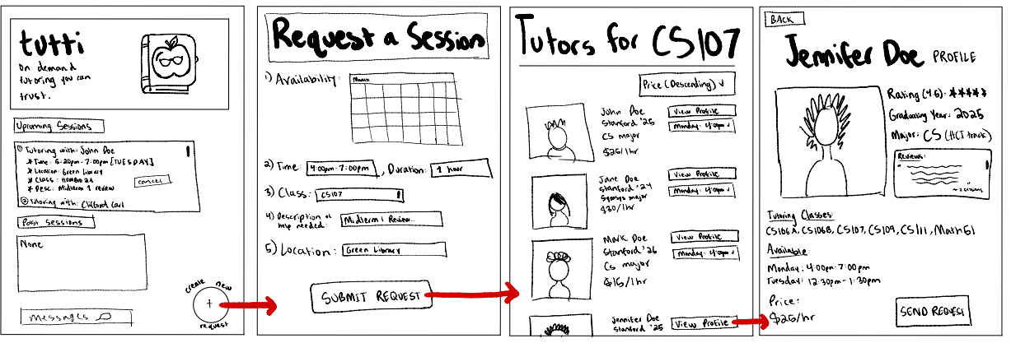
Request a Tutoring Session

Slide 22
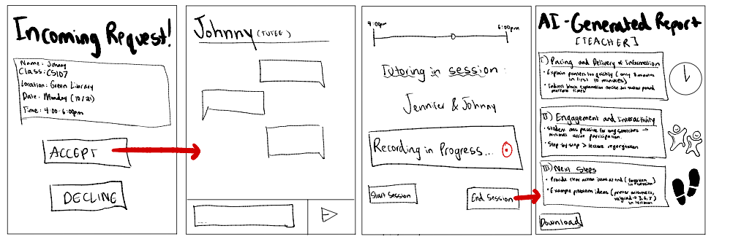
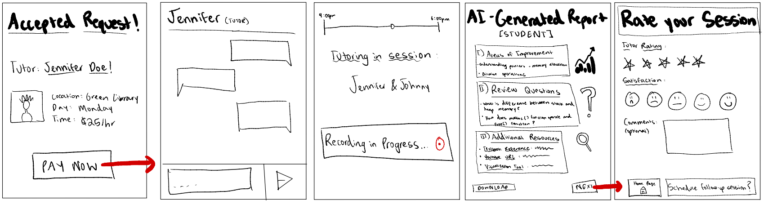
Request a Tutoring Session

Slide 23
During the Session

Slide 24
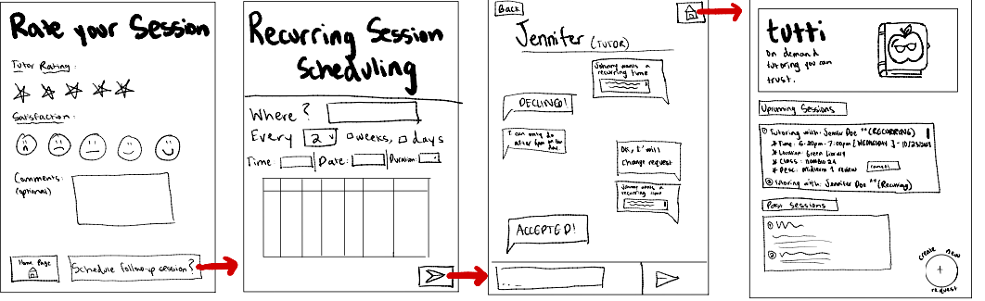
Schedule a Recurring Session

Slide 25
Tutor POV: Receiving Requests

Slide 26
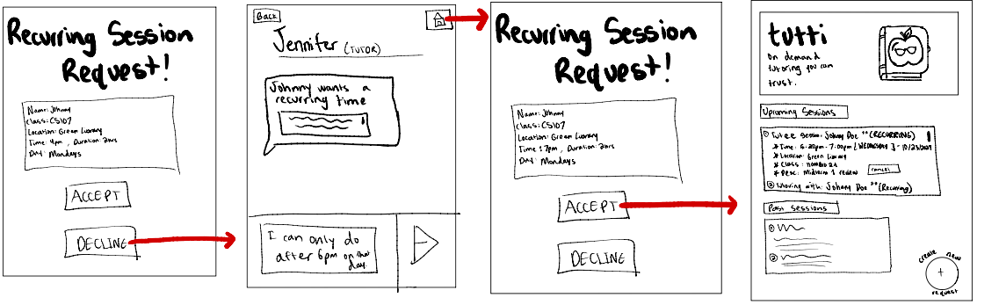
Tutor POV: Receiving Requests

Slide 27
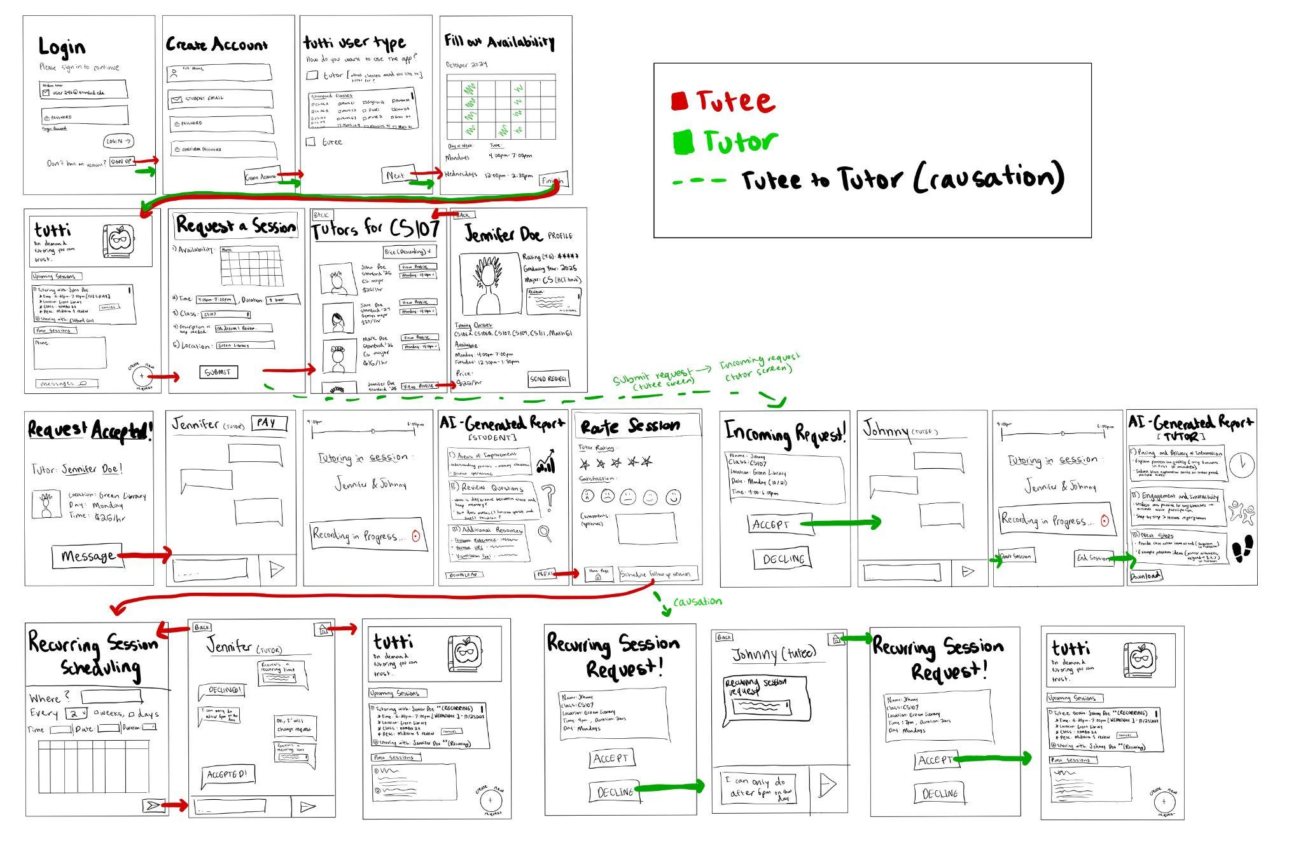
Birds-eye view image of the entire system

Slide 28
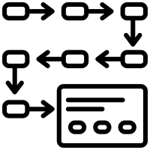
Task Flows

Slide 29
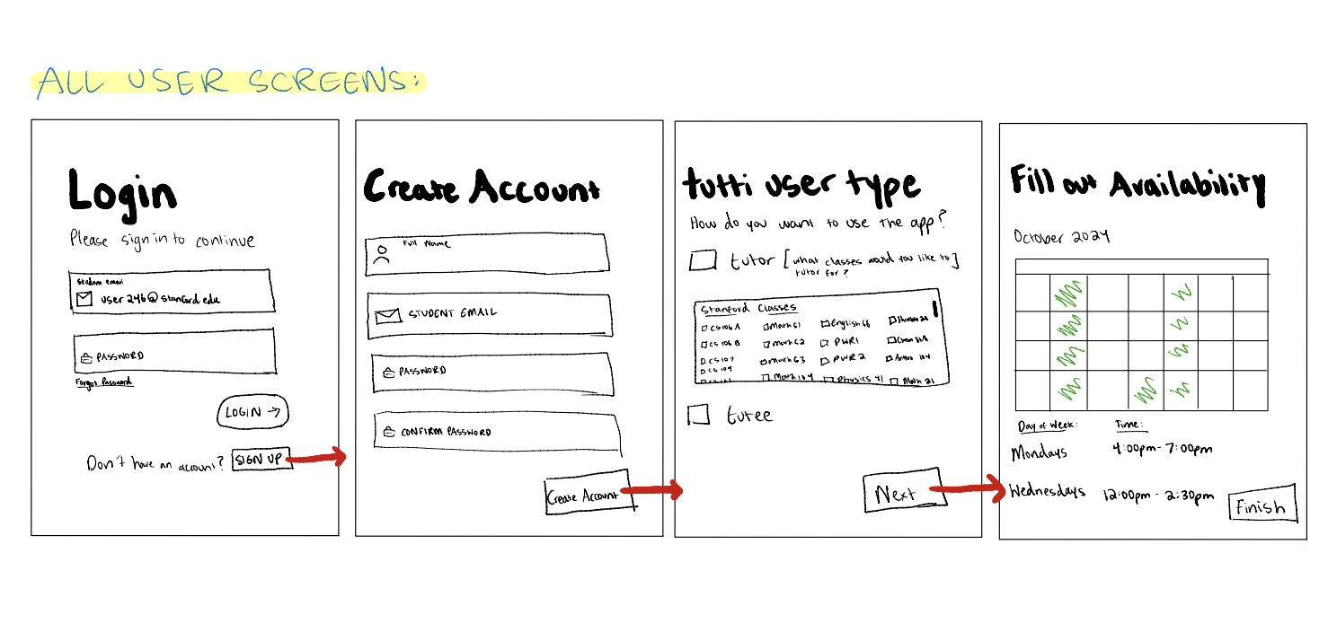
Simple Task: Creating and Setting up Profile

Slide 30
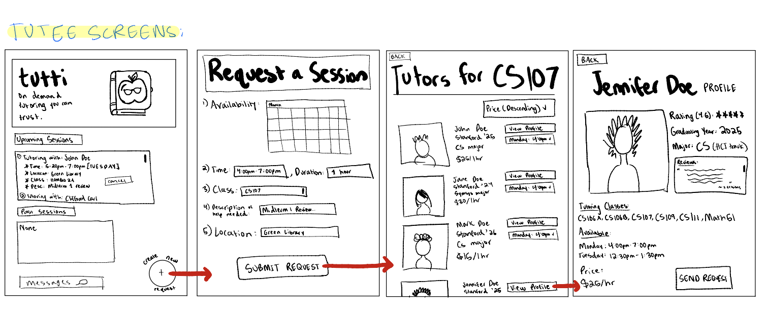
Moderate Task: Request Tutoring Session

Slide 31
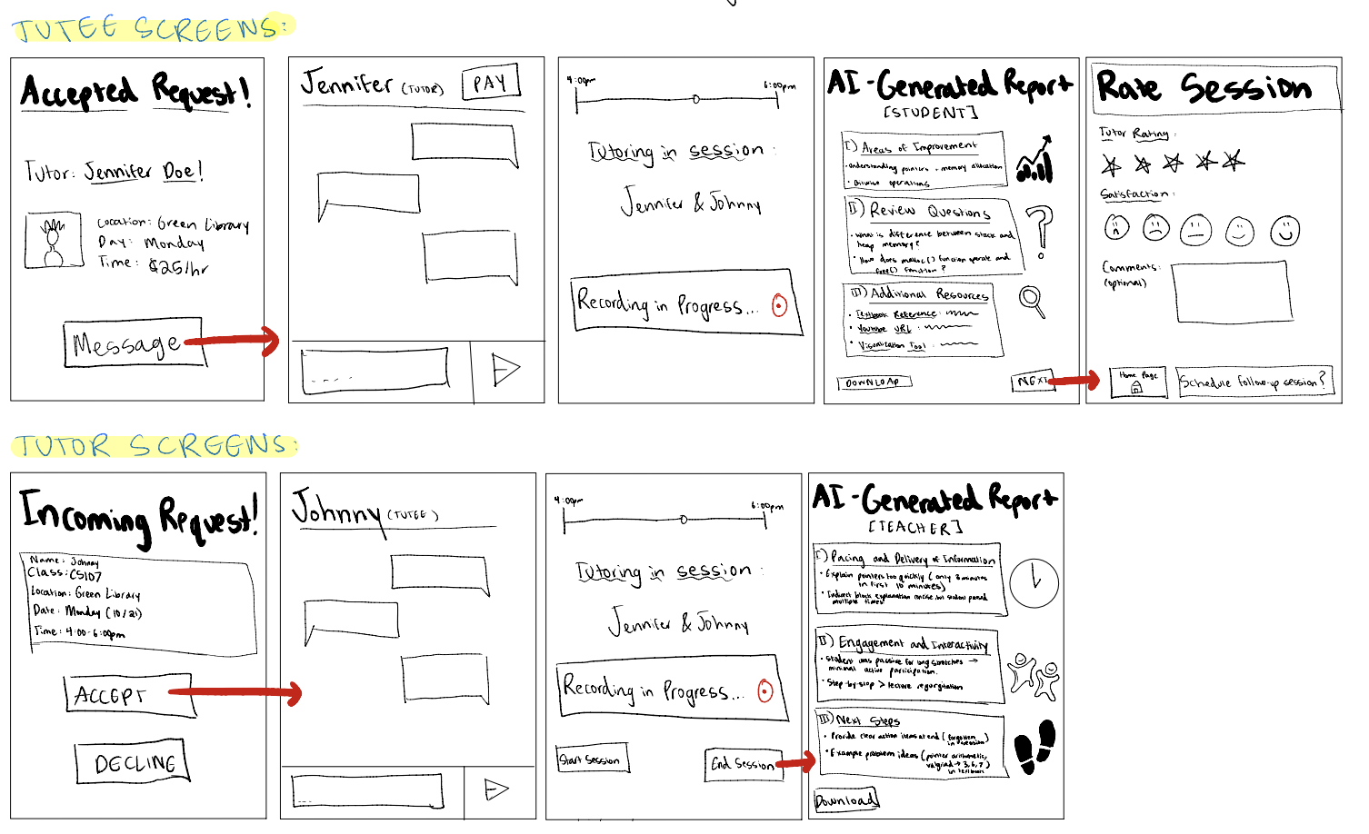
Moderate Task: Complete Tutoring Session and Receive AI-Generated Reports

Slide 32
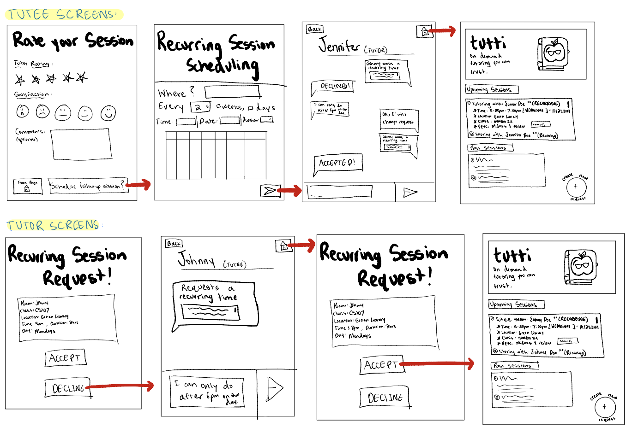
Complex Task: Process Recurring Session Request

Slide 33



Testing Methodology

Slide 34




Test Participants
John Yi
Nara Smith
Lucky Blue
Samantha Jones
Stanford '27 Major: IR Physics Classmate Compensation: N/A
High School Teacher
Cold Email Compensation: N/A
Master Student UCLA (Remote)
Met on Nextdoor
Compensation: N/A
Stanford '28
Met through Club Compensation: Coupa!

Slide 35
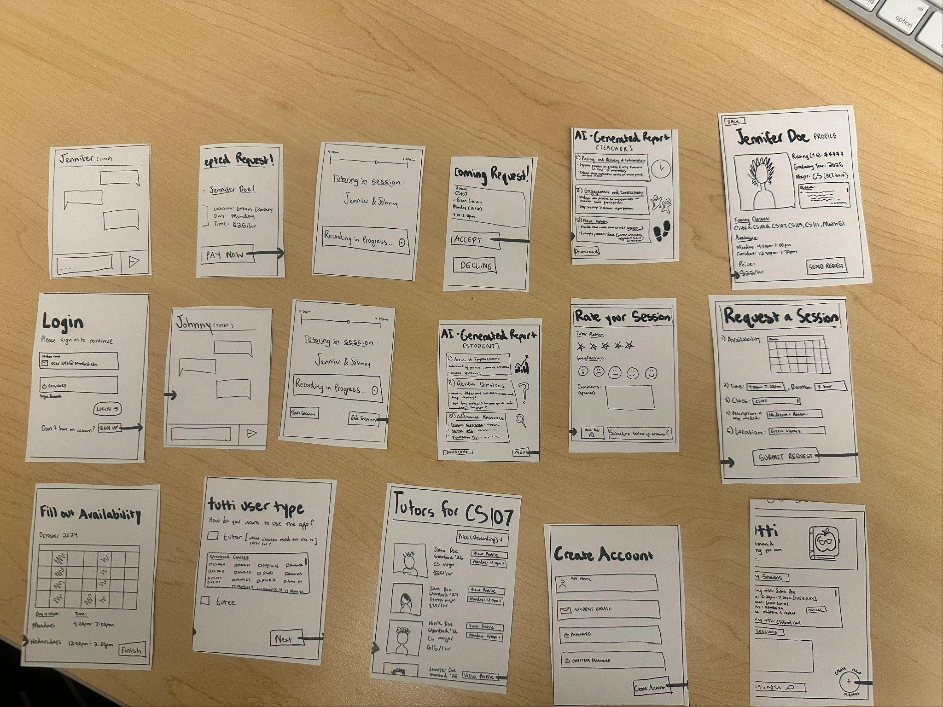
Environment and Apparatus
1
Paper Prototype
2
Participant Interaction
We used a paper prototype to simulate the app interface.
Participants interacted with paper screens laid out in front of them.
3
Manual System Response
Team members acted as the system to manually respond to user actions, mimicking the interactions.

Slide 36




Team Member Roles
Facilitator (Alex)
Conducted the session and provided prompts.
Note-takers (Jenn, Jonah)
Two team members observed and noted the participant's actions, behaviors, and comments.
Tutti (Meghana)
Another member acted as the system, changing paper screens according to user interactions.

Slide 37
Description of Procedure
Introduced participants to tutti and the paper prototype.
Provided a hypothetical scenario: Participants want to find tutoring support quickly and have downloaded the tutti app.
Simple Task: Create a profile.
Moderate Task: Request a tutoring session.
Complex Task: Set up a recurring tutoring session.
Play Tutor: Receive a tutoring request.
Participants shared their thoughts on what was intuitive or confusing.
After all tasks, participants provided general feedback and suggestions.
Participants were encouraged to think aloud to gauge understanding and intentions.

Slide 38
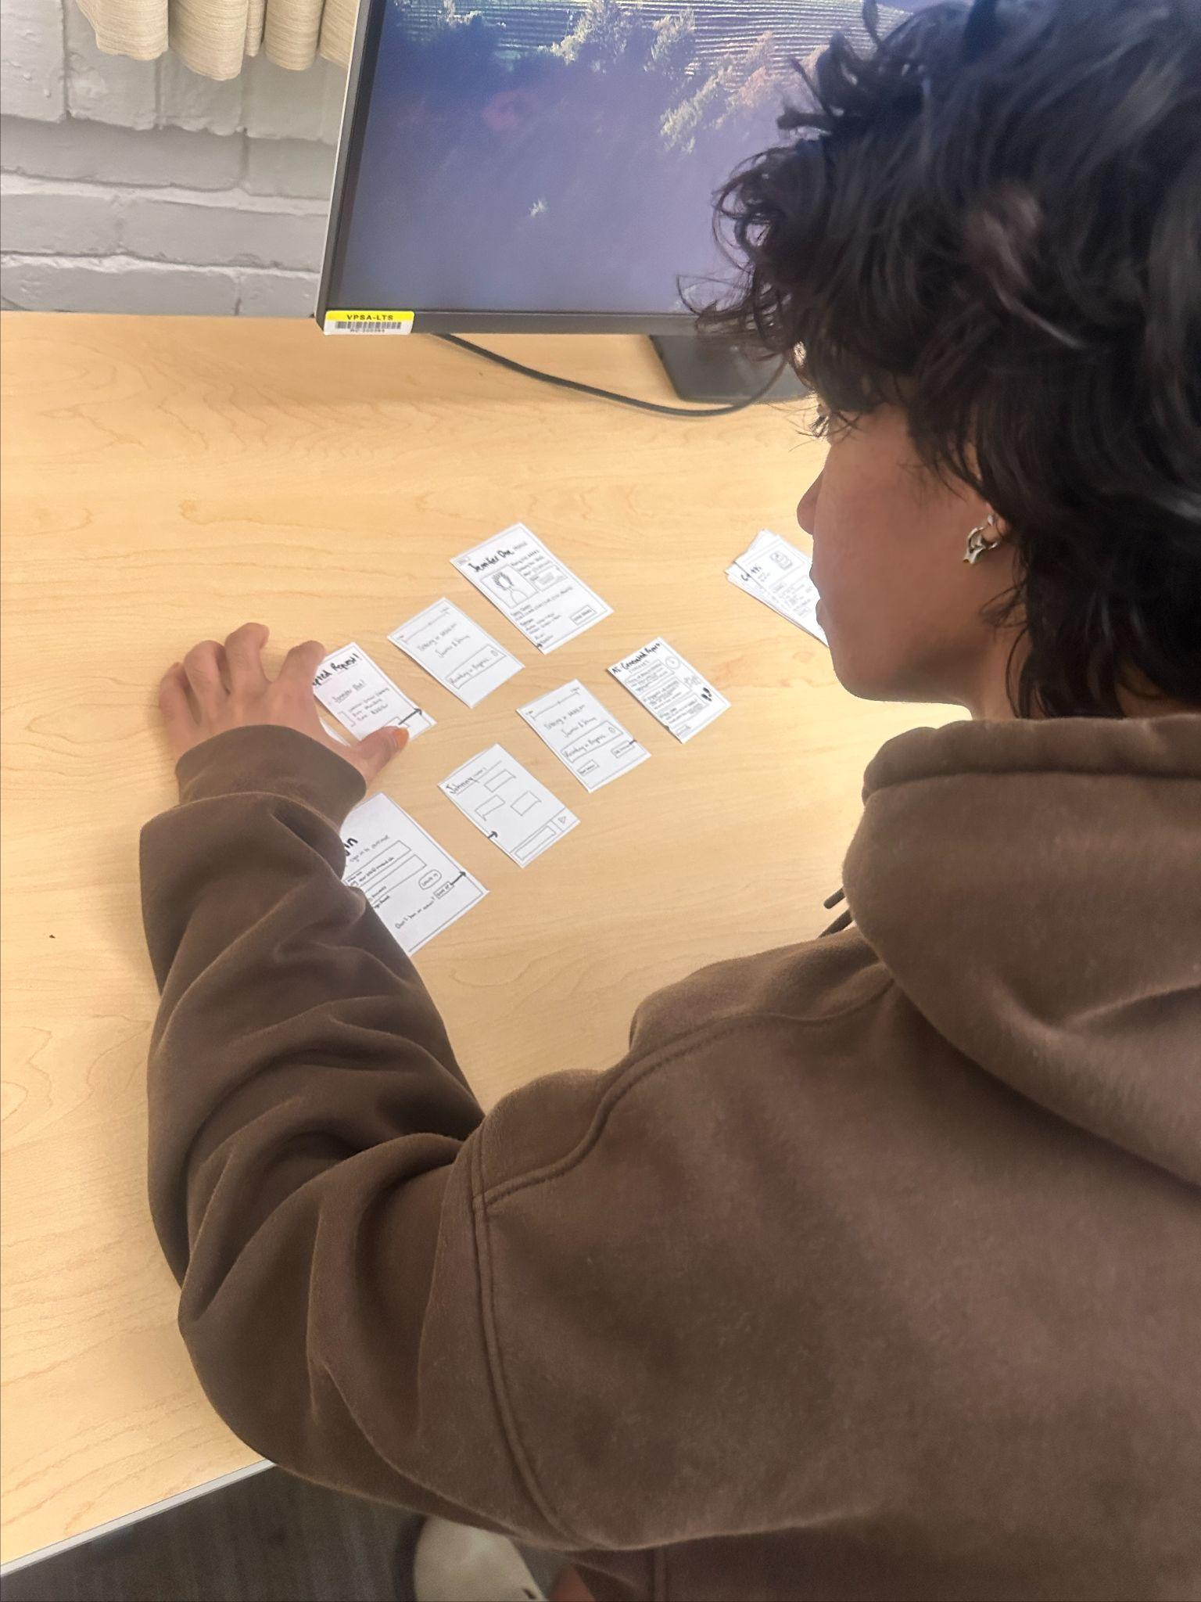
Usability Goals and Key Measurements
Intuitive Navigation
User Engagement
Number of "mis-clicks" made while interacting with the paper prototype.
Participants were asked to rate their likelihood of using different features
Ease of Task Completion
Observed the number of actions and questions participants took to complete each task.

Slide 39



Testing Results: Process Data
General Navigation
Profile Creation
Session Request
Users found the app “generally intuitive” - John
"Recurring Session" setup caused confusion
Users could easily create profiles without guidance
Forgot password was “similar to other apps” - Nara
Confusion about tutor ratings, leading to mis-clicks
“Does the tutor rate us?” was a frequent question

Slide 40



Usability Goals Achieved: Bottom Line
Intuitive Navigation
User Engagement
Ease of Task Completion
Average of 2 mis-clicks per user, primarily during session requests
Users rated the likelihood of app usage at 7.5/10
Session booking took an average of 3 questions, and 6 actions

Slide 41

Misc. Observations
Recurring Session Complexity
Calendar Integration Request
Users found it difficult to locate the recurring session option, suggesting a more prominent position
Integrating a calendar feature on the home page for session tracking was a frequent suggestion.
Customization Features
While users appreciated profile customization, they desired more tutor filtering options.

Slide 42


How well did we achieve our goals?
Intuitive Navigation
User Engagement
Ease of Task Completion
Navigation received positive feedback, with minor concerns regarding button labeling.
Participants showed a strong interest in using the app, particularly for its convenience and ai features
The average of 3 questions on average to book a session, we need a more intuitive flow

Slide 43
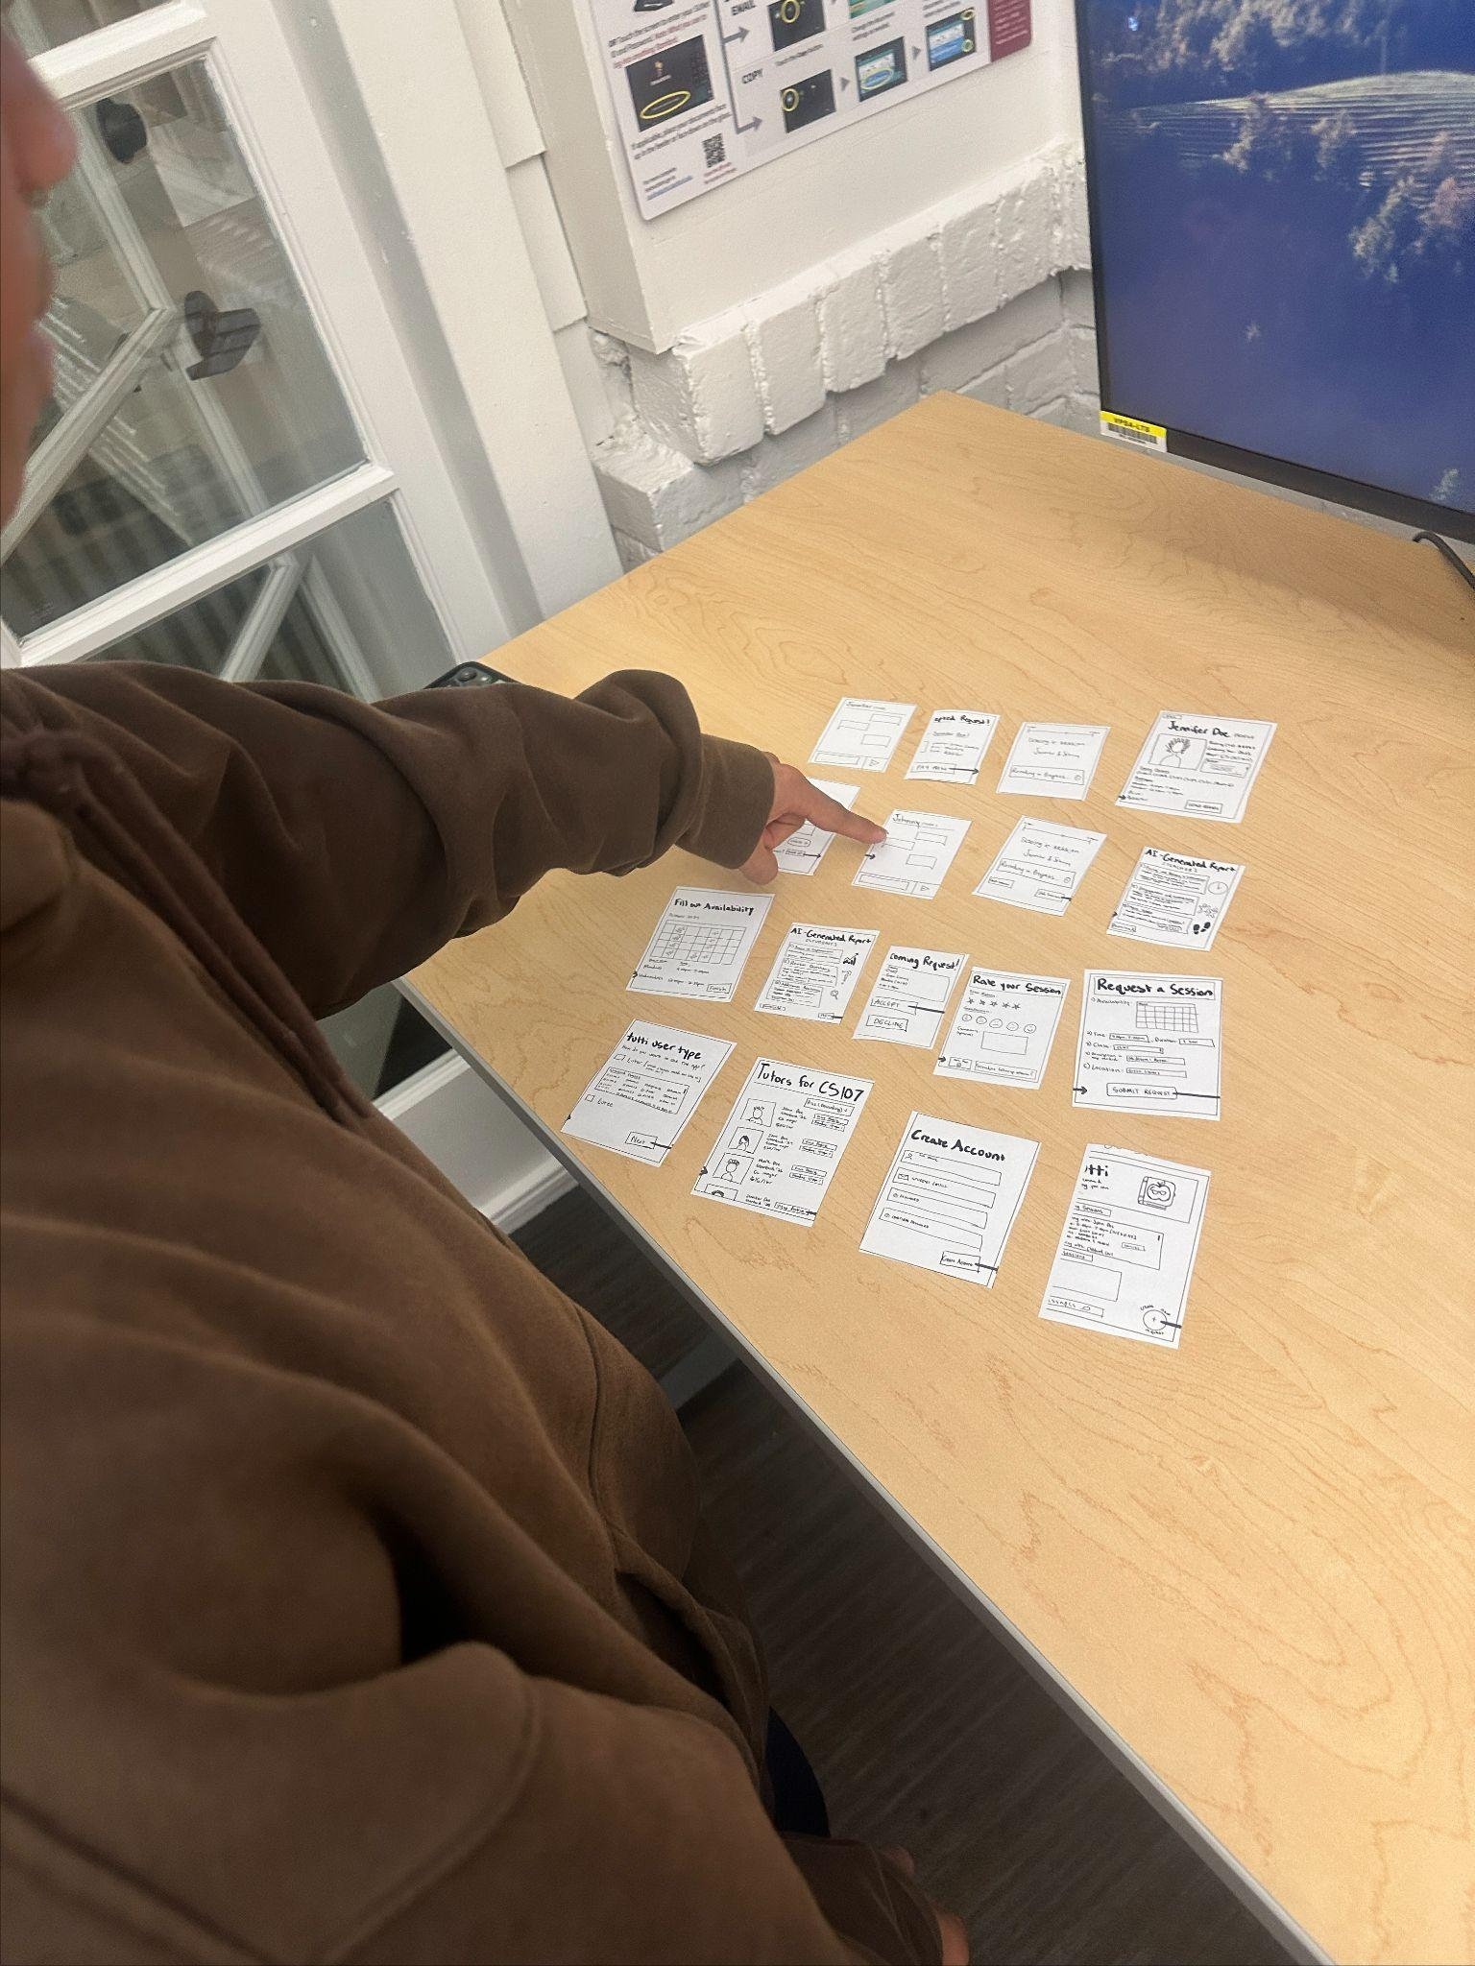
Implications of Findings
1
Improving Navigation
2
Feature Visibility
Clearer button labels, especially for complex tasks like recurring sessions
Prioritizing and increasing the visibility of key features, such as recurring sessions
3
User Interest in Customization
Enhanced customization options, including calendar integration and tutor filtering, can significantly improve user satisfaction.

Slide 44





Design Changes
Enhanced Button Labels
Updating button labels will improve clarity and reduce mis-clicks.
Prominent Feature Placement
Moving the recurring session feature to the book a session screen will improve its accessibility.
Calendar Integration
A calendar integration on the home page will allow users to easily manage session schedules.
More Filter Options
Adding more tutor filtering options, such as availability and specific skills, will enhance the user experience.

Slide 45



Shortcomings/Limitations of Testing
Long-Term Engagement
The short testing duration couldn't determine long-term app usage. Longer-term studies are needed.
Group Session Dynamics
Testing focused on individual sessions; the effectiveness of group sessions remains unknown.
The prototype didn't consider high user volume. Further testing is required to evaluate scalability.
Scalability

Slide 46

Appendix
The following sections contain additional information and details about our testing process, including a full list of pros and cons for our selected interface rationale, critical incidents observed during testing, and the script outline used for conducting the usability tests.

Slide 47
Full list of Pros and Cons for Selected Interface Rationale
Cons:
Screen Size Limitations: The smaller screen size on mobile devices limits how much information can be displayed at one time. This is particularly challenging for showing detailed tutor profiles, in-depth session notes, or analytics about a student’s progress. It requires careful design to avoid overwhelming the user while still providing all necessary information.
Battery Consumption: Frequent app usage may lead to increased battery consumption, which can deter users, especially those with limited charging access throughout the day. Battery-intensive features, such as live video tutoring or location tracking, could further exacerbate this issue.
File Upload Complexity: Handling larger files, like assignments or detailed study materials, can be more challenging on mobile compared to desktop. Uploading documents might be cumbersome due to slower mobile processing speeds, network limitations, or the general inconvenience of navigating file structures on a smaller screen.
Distractions and Competing Apps: Mobile devices are filled with distractions such as social media, games, and other notifications. When students are using tutti, they are prone to interruptions, which could impact the effectiveness of tutoring sessions or disrupt the booking flow.
Multiple Operating Systems: Developing for both iOS and Android presents unique challenges. Each operating system has different design guidelines, functionalities, and restrictions. Ensuring a consistent user experience across these platforms requires additional resources in development and testing, and discrepancies could impact the user experience for one group of users.
Privacy Concerns: Mobile apps often request permissions (e.g., location, camera, storage) that can raise privacy concerns among users. Addressing these concerns through transparent data practices and securing sensitive information is essential to build trust with the user base.
Pros:
Convenient & Accessible: Mobile phones are something students always carry, making tutoring support accessible anytime, anywhere. This means students can easily reach out for academic help during breaks, on the go, or even in-between classes, which enhances the likelihood of frequent engagement.
Frequent Usage: Smartphones are used multiple times throughout the day, and this habitual usage increases the likelihood that students will see tutoring-related notifications. This frequent exposure encourages users to take action, such as booking sessions, and keeps the tutoring service top of mind.
Broad Adoption: Nearly all college students own a smartphone, making a mobile app the most accessible platform compared to wearables or web-only solutions. This universal accessibility ensures that tutti can reach its target market without requiring students to purchase new technology or adapt to unfamiliar devices.
Internet Connectivity: The mobile app can leverage mobile data and Wi-Fi, ensuring that students can connect with a tutor anywhere—whether on campus or at home. This connectivity also allows seamless updates, such as real-time notifications, ensuring users are always in the loop regarding session reminders or changes.
User-Familiarity: Most students are already comfortable navigating mobile applications, which reduces the learning curve. This familiarity means students can start using the app with little to no instruction, leading to better initial engagement and lower dropout rates during onboarding.

Slide 48
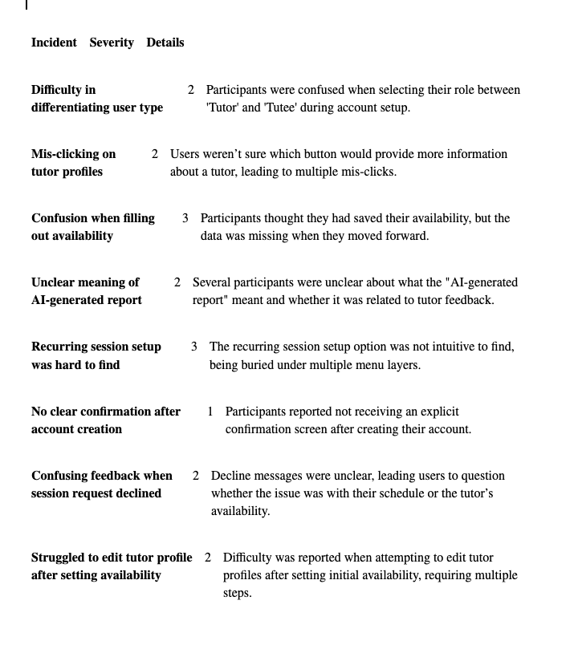
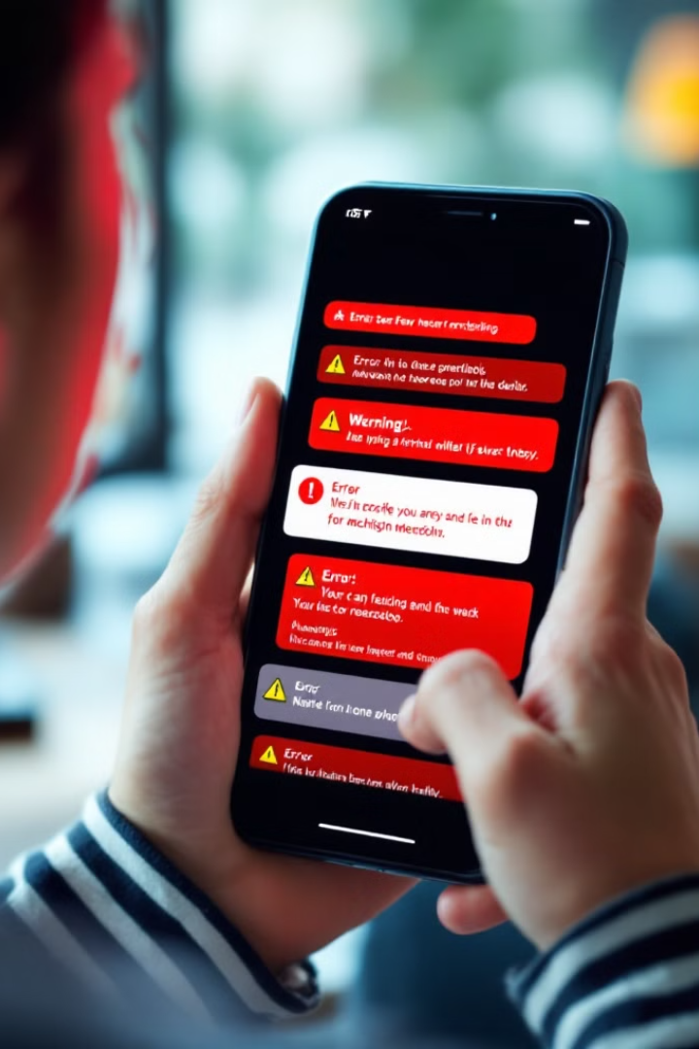
Critical Incidents

Slide 49
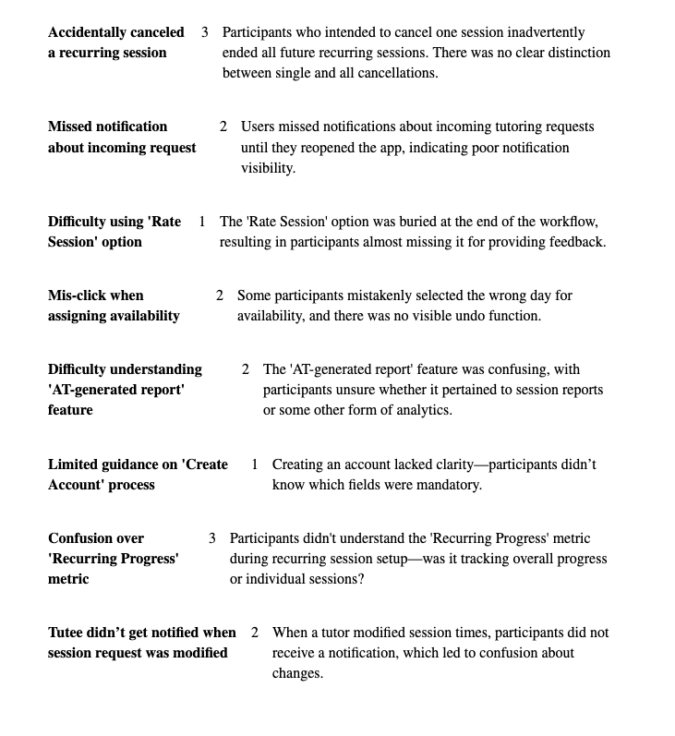
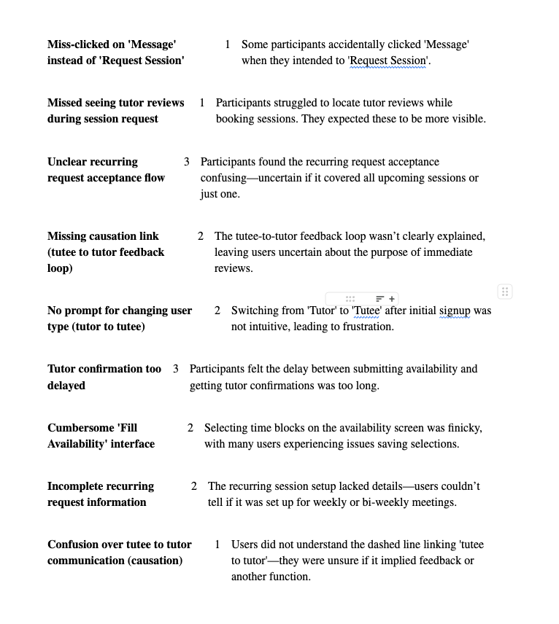
Critical Incidents

Slide 50
Script Outline
1
Introduction
"Hi, thank you for joining us today. We're going to test a low-fidelity version of our tutoring app, tutti. The goal is to see how easily you can use the app to complete common tasks, such as finding a tutor or managing a session. Feel free to ask questions as we go along."
2
Scenario Setup
"Imagine that you're a college student looking for some extra academic help. You've just downloaded tutti to quickly find tutors for your coursework. Let's see how you get started!"
3
Tasks
1. Profile Creation 2. Request a Tutoring Session 3. Recurring Session Setup
4
Post-Task Reflection
"Great! Now that we're done, could you tell me which features felt clear and intuitive, and which features you found confusing or hard to use? How likely are you to use this app in your daily routine?"
5
Closing
"Thanks again for your time and feedback today. We really appreciate your insights as they will help us make tutti better for students like you."

